Slide 1
Supporting SIFE with Co-Teaching
Jamie Wolfe
Knox County Schools ELL instructional coach

Slide 2
AGENDA
Co-Teaching
Definition
Co-Teaching Models
01
02
Co-Teaching
Examples
Discussion
03
04

Slide 3
MEETING OBJECTIVES
Define co-teaching.
Recognize different co-teaching models.
Analyze co-teaching examples.

Slide 4
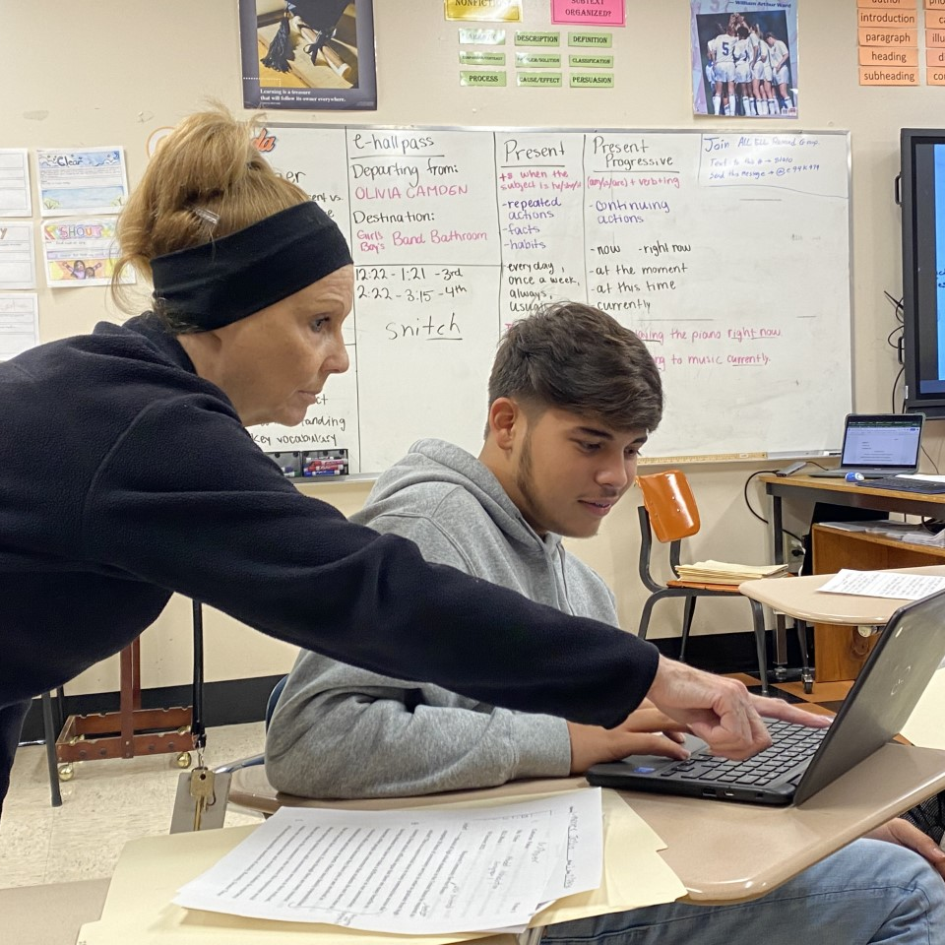
01
What is Co-Teaching?

Slide 5
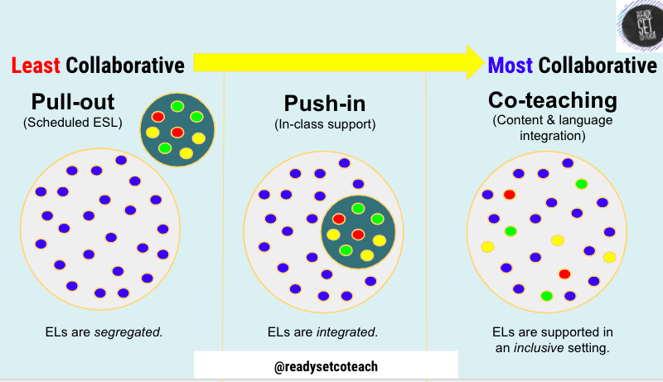
Collaboration Continuum
Notes:
Visual of h

Slide 6
Co-Teaching for ELs
Co-Teaching is….
Co-Teaching is not…
2 teachers sharing responsibility for all students AND teaching both content AND language
2 teachers committed to sharing all 4 steps of the instructional process (plan, teach, assess, reflect)
Additional support for SIFE students
An opportunity to grow professionally
Most effective if class is around ⅓ ELs OR sheltered class
Tutoring
Translating
Just showing up and winging it
Your kids/my kids

Slide 7
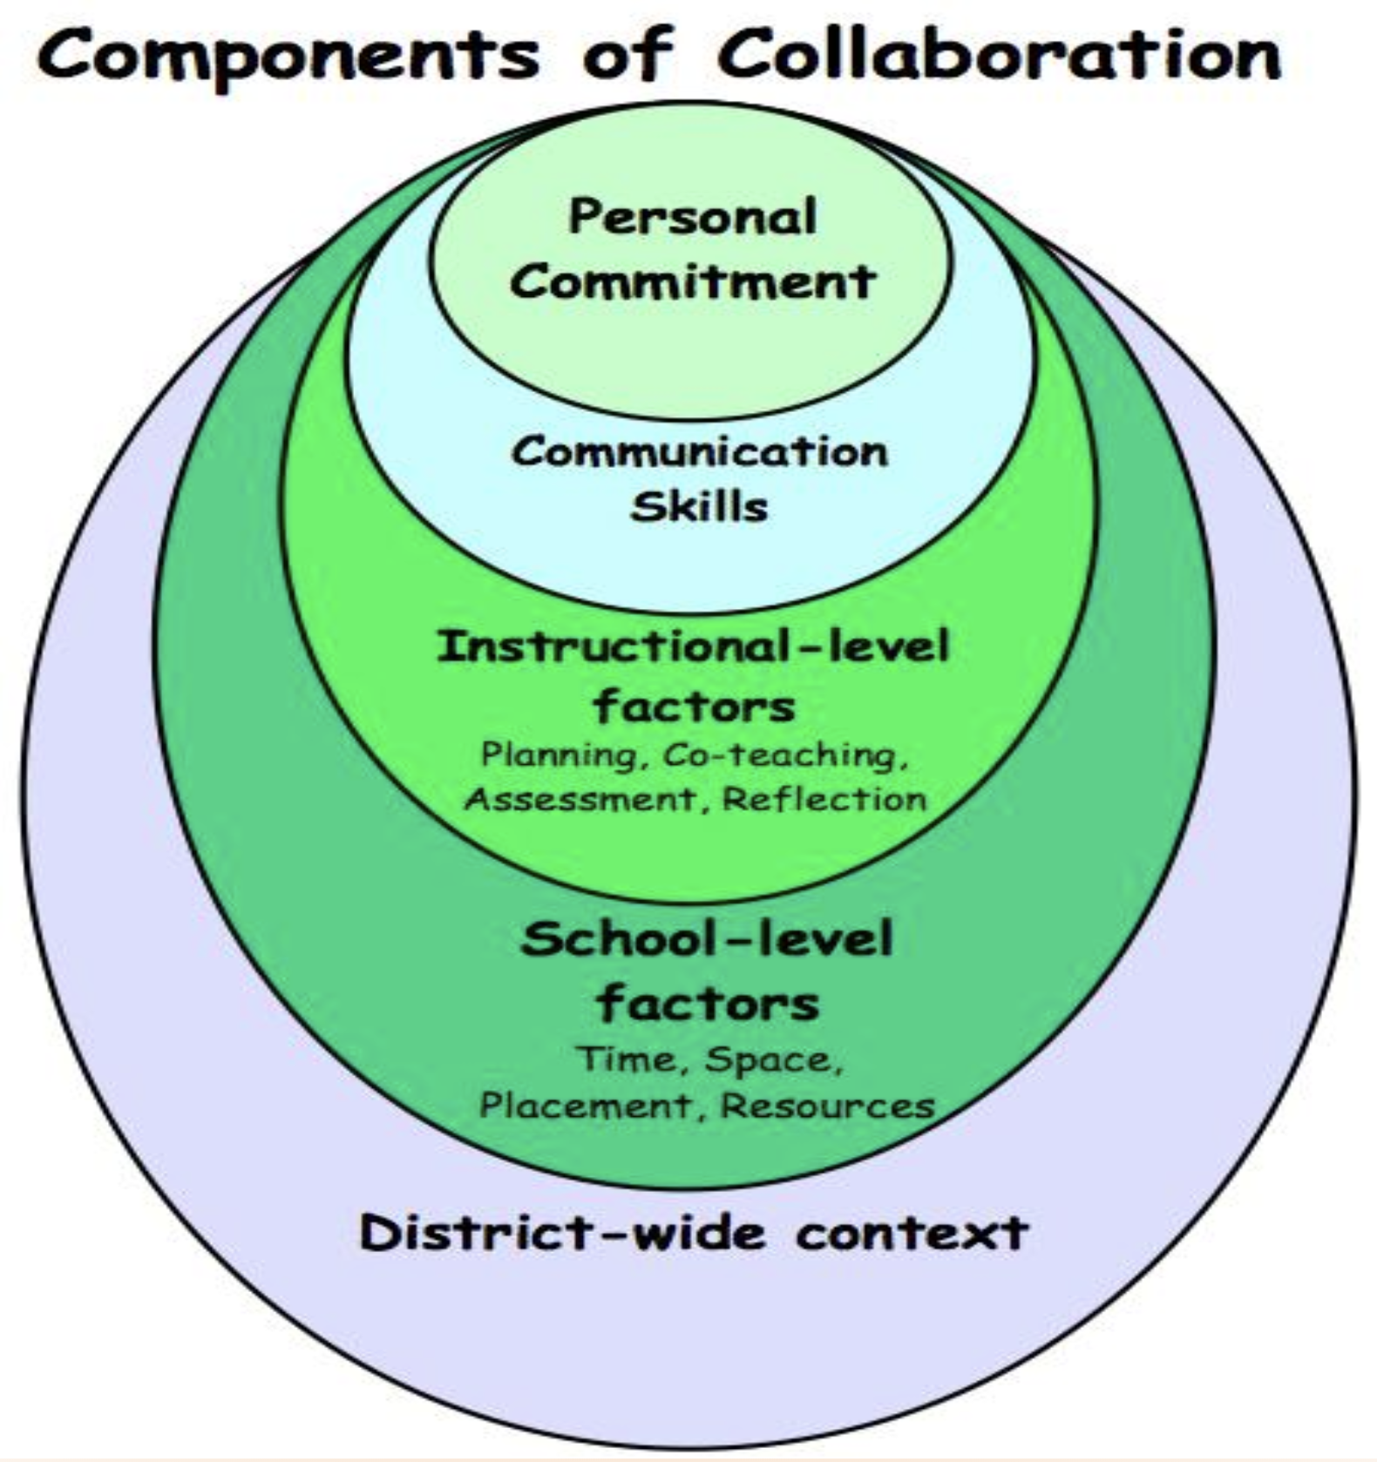
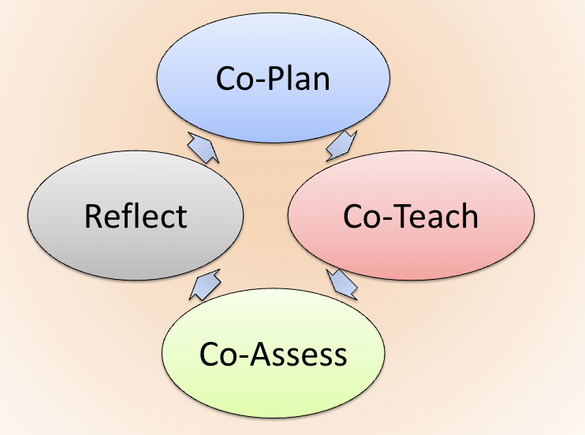
Conditions Needed for Co-Teaching
Notes:
#1 Both teachers have to want to do it!
#2 Both teachers have to commit to communicating - maybe digitally, maybe in-person. Respect is essential.
#3 Both teachers participate in all steps of instruction.
#4 School and district support - time for co-planning, co-assessing, & reflecting & ongoing PD

Slide 8
02
Co-Teaching Examples

Slide 9
Jamie’s Experiences
Sheltered ELA
Math Support
Science Support
Notes:
6th grade sheltered ELA 21-22: Participation in the ELL inclusion program correlated with a growth of 6 percentile points above the district average for other ELL students (on TCAP). The effect size associated with participation in the ELL inclusion program at Northwest on ELA TCAP percentiles would again be classified as a medium positive effect. On WIDA Access: Compared to the average 6th grade ELL student in the district, participation in the ELL inclusion program at Northwest resulted in an additional 14 points of growth in the WIDA composite score. The students participating in the program scored, on average, about 21 points higher than their Northwest peers who did not participate in the program. The effect sizes associated with the students in the ELL inclusion program would be classified as a medium positive effect.

Slide 10
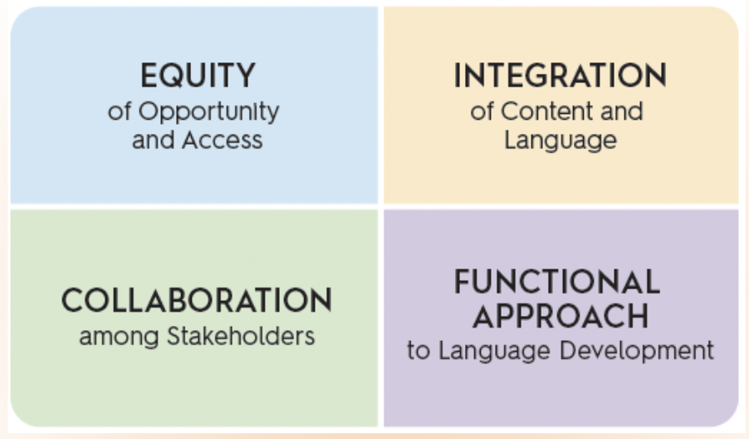
Why consider co-teaching?
Notes:
We need to collaborate in order to best integrate content and language.

Slide 11
RESOURCES
Ready, Set, Co-Teach Padlet
Co-Planning Documents
Book

Slide 12
03
Discussion

Slide 13
What has worked for you?
What opportunities do you have?
What questions do you have?
Describe your success collaborating and/or co-teaching with content teachers.
How might you expand your collaboration and/or co-teaching to support SIFE students?
Let’s help each other!

Slide 14
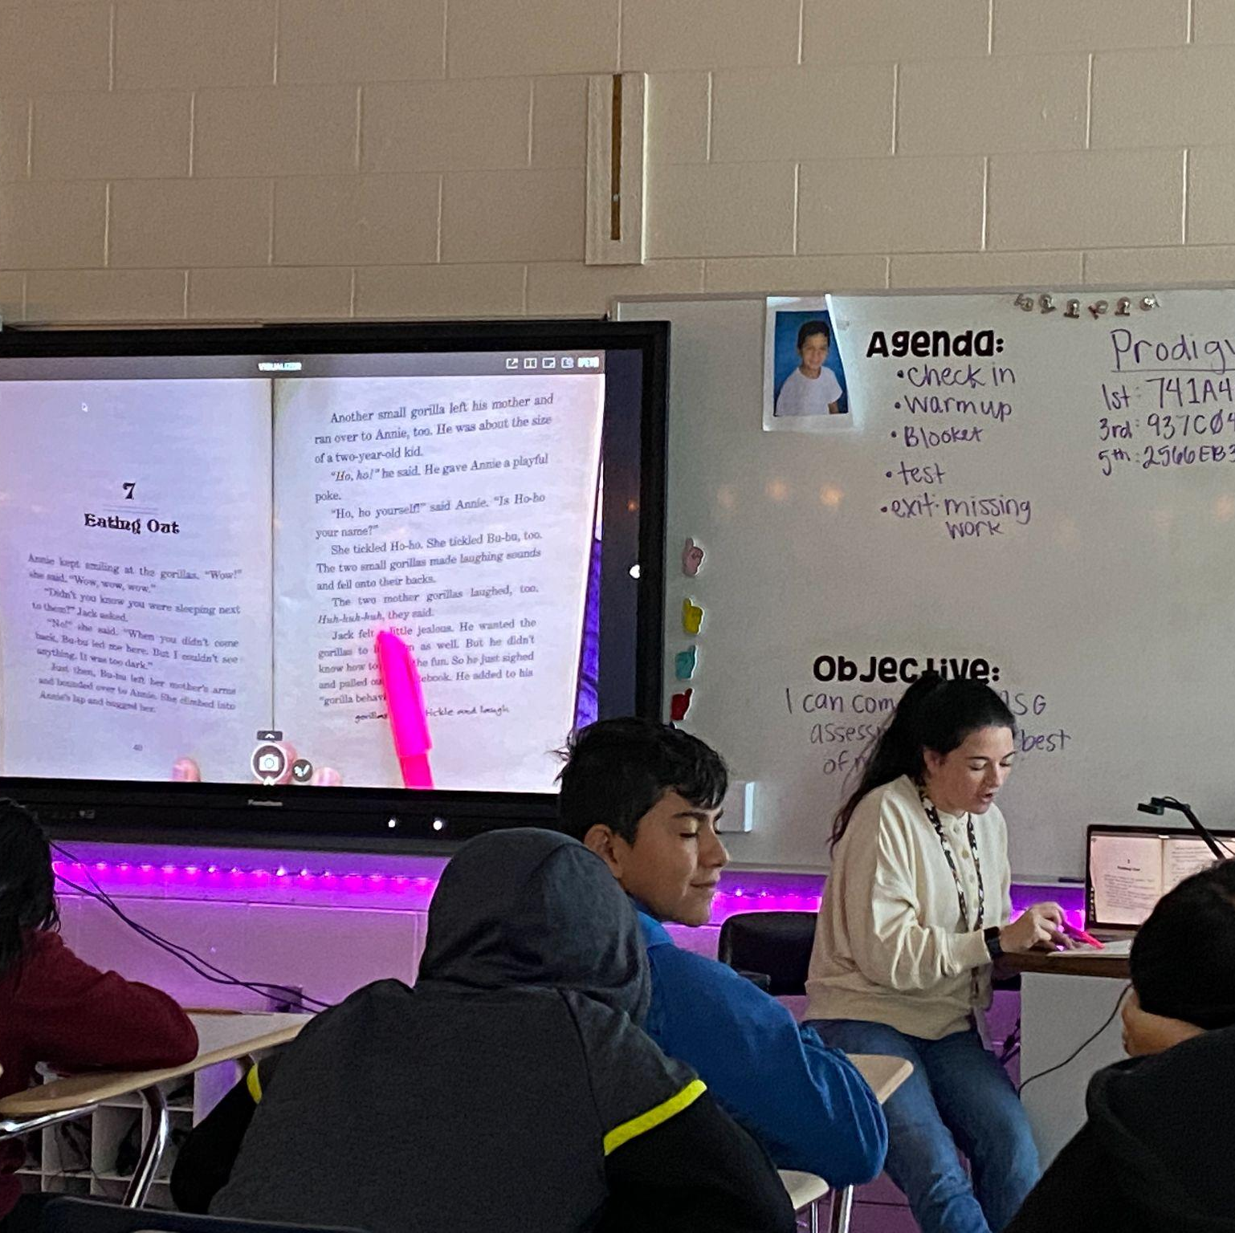
02
Co-Teaching Models

